Slide 1
Formal Description of a Problem
In AI, we will formally define a problem as
a space of all possible configurations where each configuration is called a state
thus, we use the term state space
an initial state
one or more goal states
a set of rules/operators which move the problem from one state to the next
In some cases, we may enumerate all possible states (see monkey & banana problem on the next slide)
but usually, such an enumeration will be overwhelmingly large so we only generate a portion of the state space, the portion we are currently examining
we will view our state space as a graph or network and apply graph algorithms to search through the space

Slide 2
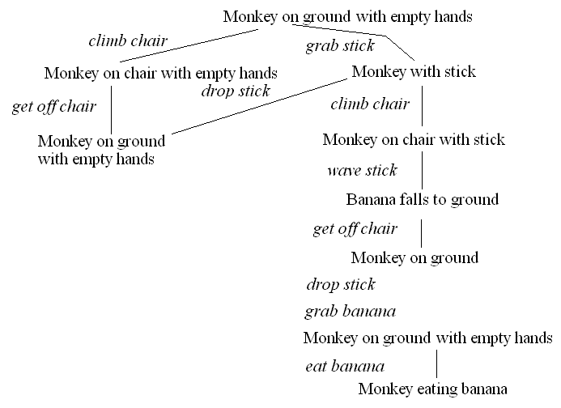
The Monkey & Bananas Problem
A monkey is in a cage and bananas are suspended from the ceiling, the monkey wants to eat a banana but cannot reach them
in the room are a chair and a stick
if the monkey stands on the chair and waves the stick, he can knock a banana down to eat it
what are the actions the monkey should take?
Initial state:
monkey on ground
with empty hand
bananas suspended
Goal state:
monkey eating
Actions:
climb chair/get off
grab X
wave X
eat X

Slide 3
Missionaries and Cannibals
3 missionaries and 3 cannibals are on one side of the river with a boat that can take exactly 2 people across the river
how can we move the 3 missionaries and 3 cannibals across the river
with the constraint that the cannibals never outnumber the missionaries on either side of the river (lest the cannibals start eating the missionaries!)??
We can represent a state as a 6-item tuple:
(a, b, c, d, e, f)
a/b = number of missionaries/cannibals on left shore
c/d = number of missionaries/cannibals in boat
e/f = number of missionaries/cannibals on right shore
where a + b + c + d + e + f = 6 and c + d <= 2, c + d >= 1 to move the boat
a >= b unless a = 0, c >= d unless c = 0, e >= f unless e = 0
Legal operations (moves) are
0, 1, 2 missionaries get into boat (c + d must be <= 2)
0, 1, 2 missionaries get out of boat
0, 1, 2 cannibals get into boat (c + d must be <= 2)
0, 1, 2 missionaries get out of boat
boat sails from left shore to right shore (c + d must be >= 1)
boat sails from right shore to left shore (c + d must be >= 1)
drawing the state space will be left as a homework problem

Slide 4
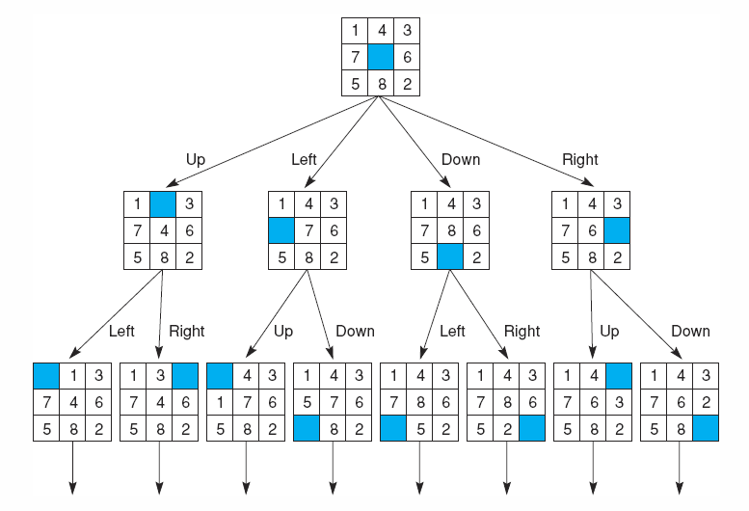
8 Puzzle
The 8 puzzle search space consists of 8! states (40320)

Slide 5
Graph/Network Theory
A graph is denoted as G = {V, E}
V = set of vertices (nodes)
E = set of edges
an edge is denoted as (a, b) to indicate an edge exists between node a and node b
a network is a graph in which edges have weights (the cost of traversing from one node to another)
A graph is directed if an edge can only be traversed in one direction
in a directed graph, (a, b) does not mean there exists (b, a) but in an undirected graph, (a, b) = (b, a)
A path is a set of 1 or more edges that lead you from one node to another
A graph contains a cycle if there is a path whose length > 1 such that you can go from a node back to itself
A tree is a special case of a graph which contains no cycles and nodes are given relationships of parents and children – the root of a tree is the topmost node (has no parents) and leafs are nodes that have no children

Slide 6
Search
Given a problem expressed as a state space (whether explicitly or implicitly)
with operators/actions, an initial state and a goal state, how do we find the sequence of operators needed to solve the problem?
this requires search
Formally, we define a search space as [N, A, S, GD]
N = set of nodes or states of a graph
A = set of arcs (edges) between nodes that correspond to the steps in the problem (the legal actions or operators)
S = a nonempty subset of N that represents start states
GD = a nonempty subset of N that represents goal states
Our problem becomes one of traversing the graph from a node in S to a node in GD
we can use any of the numerous graph traversal techniques for this but in general, they divide into two categories:
brute force – unguided search
heuristic – guided search

Slide 7
Consequences of Search
As shown a few slides back, the 8-puzzle has over 40000 different states
what about the 15 puzzle?
A brute force search means try all possible states blindly until you find the solution (blindly means without knowledge guiding you)
if a problem has a state space that consists of n moves where each move has m possible choices, then there are 2^{m*n} states
two forms of brute force search are: depth first search, breath first search
A guided search uses some heuristic (a function) to determine how good a particular state is to help determine which state to move on to - goodness is a judgment of how likely this node is to lead you to a goal state
hill climbing
best-first search
A/A* algorithm
Minimax
While a good heuristic can reduce the complexity from 2^{m*n} to something tractable, there is no guarantee so any form of search is O(2^{n}) in the worst case

Slide 8
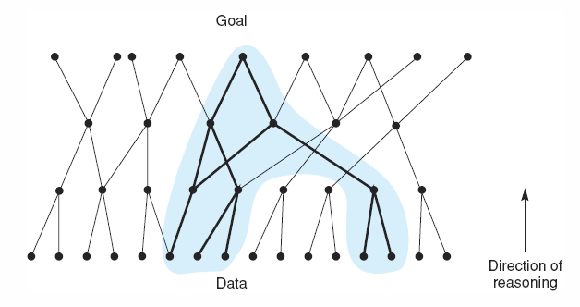
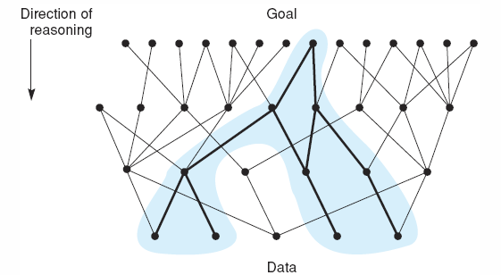
Forward vs Backward Search
The common form of reasoning starts with data and leads to conclusions
for instance, diagnosis is data-driven – given the patient symptoms, we work toward disease hypotheses
we often think of this form of reasoning as “forward chaining” through rules
Backward search reasons from goals to actions
Planning and design are often goal-driven
“backward chaining”

Slide 9
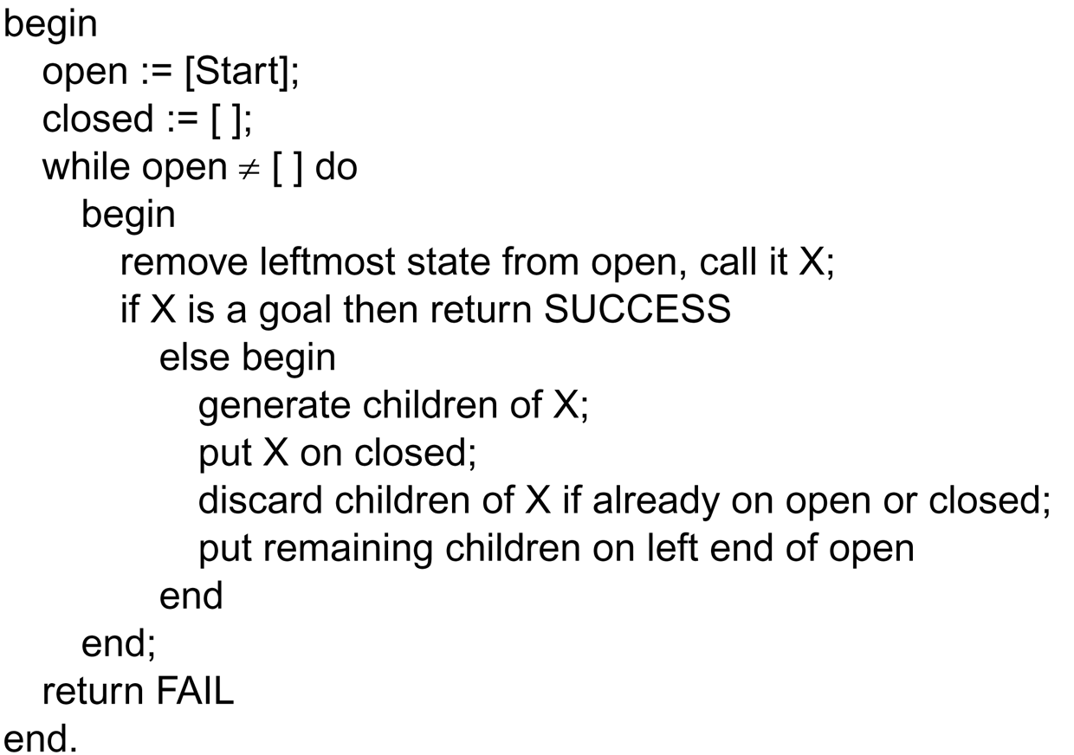
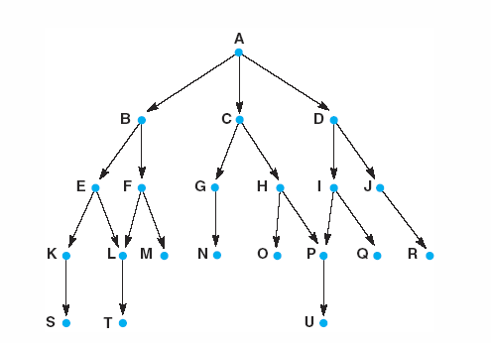
Depth-first Search
Starting at node A, our search gives us:
A, B, E, K, S, L, T, F, M, C, G, N, H, O, P,
U, D, I, Q, J, R

Slide 10
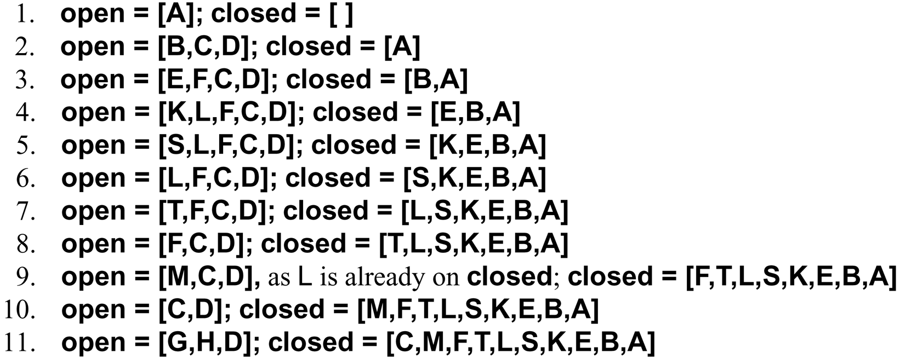
Depth-first Search Example

Slide 11
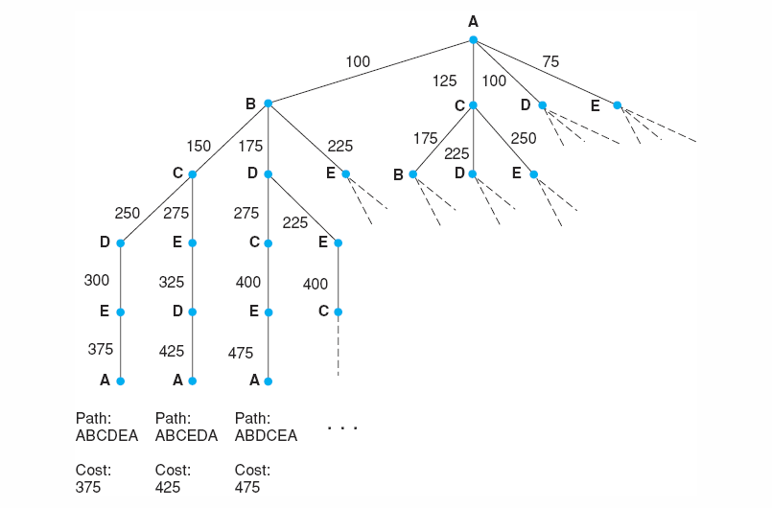
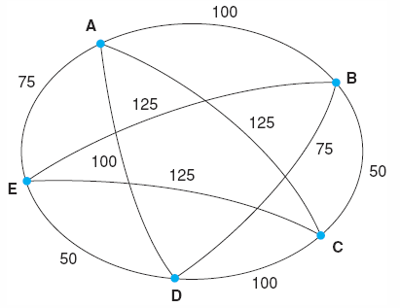
Traveling Salesman Problem

Slide 12
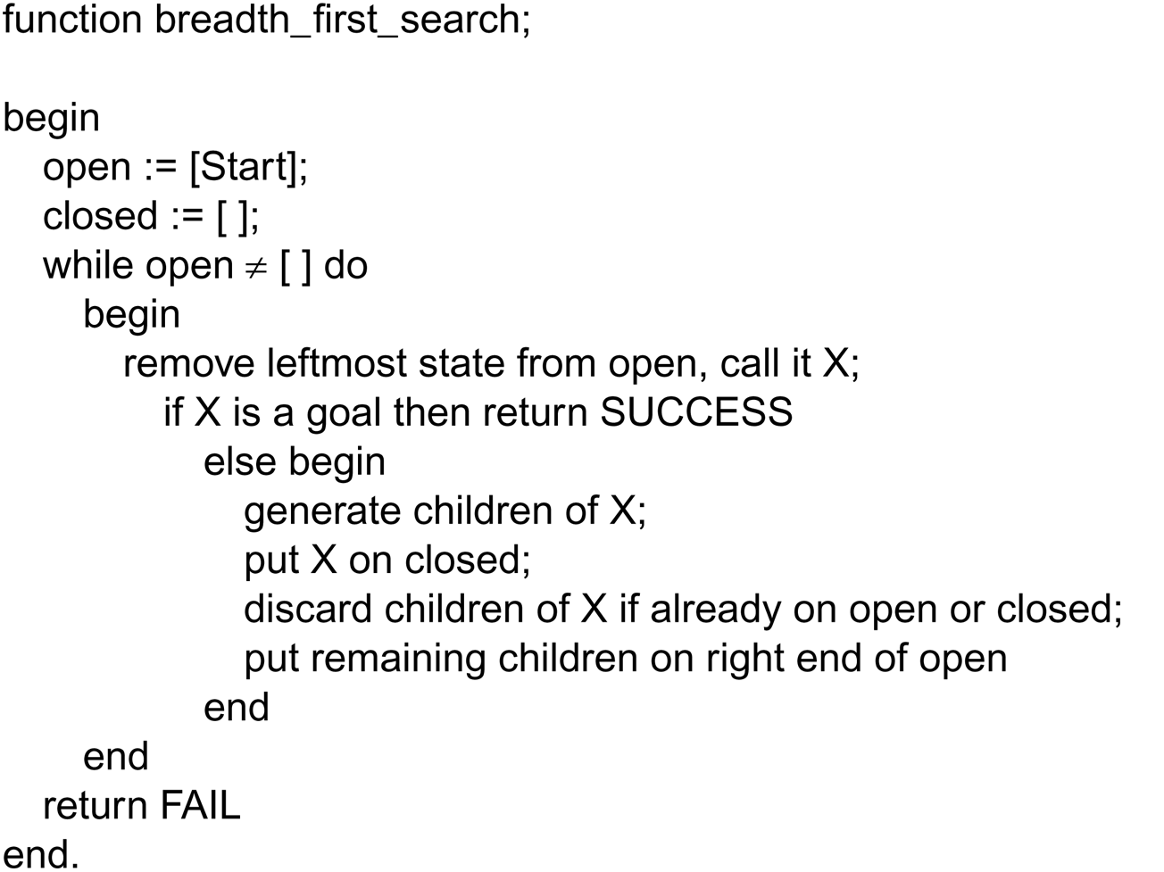
Breadth-First Search
Starting at node A, our search would generate the
nodes in alphabetical order from A to U

Slide 13
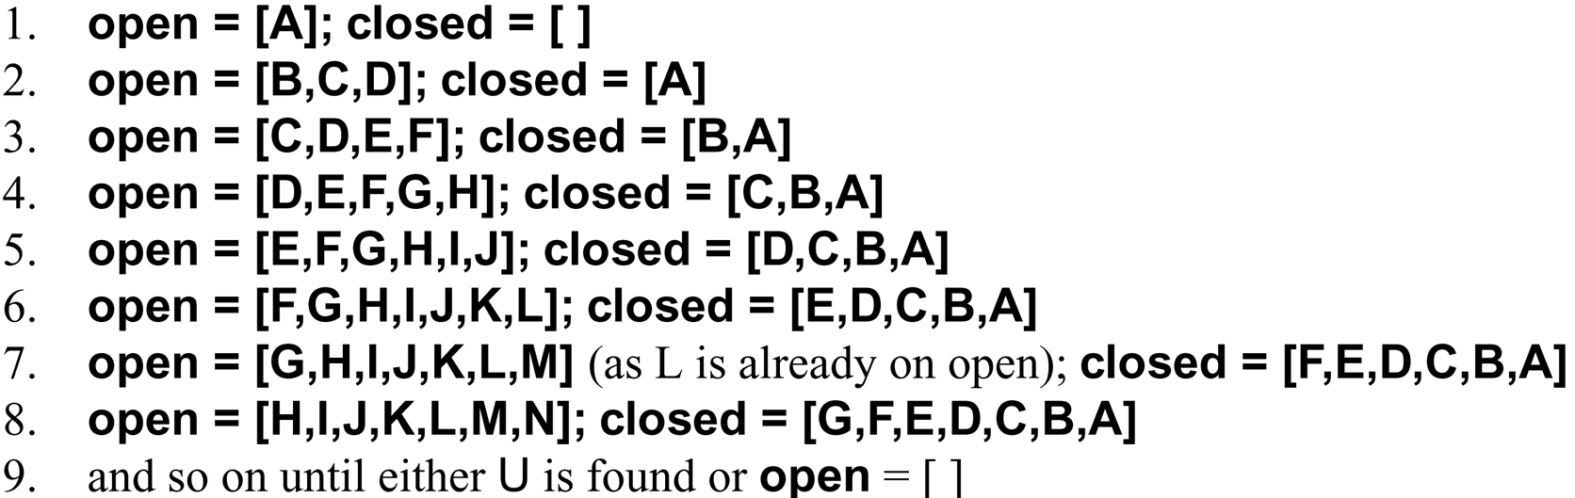
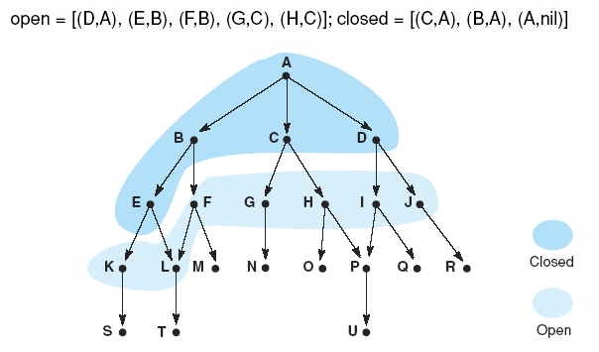
Breadth-First Search Example

Slide 14
8 Queens
Can you place 8 queens on a chess board such that no queen can capture another?
uses a recursive algorithm with backtracking
the more general problem is the N-queens problem (N queens on an NxN chess board)
solve(board, col, row)
if col = n then return true; // success
else
row = 0; placed = false;
while(row < n && !placed)
board[row][col] = true // place the queen
if(cannotCapture(board, col)) placed = true
else
board[row][col] = false; row++
if(row = n)
col--; placed = false; row = 0; // backtrack

Slide 15
And/Or Graphs
To this point in our consideration of search spaces, a single state (or the path to that state) represents a solution
in some problems, a solution is a combination of states or a combination of paths
we pursue a single path, until we reach a dead end in which case we backtrack, or we find the solution (or we run out of possibilities if no solution exists)
so our state space is an Or graph – every different branch is a different solution, only one of which is required to solve the problem
However, some problems can be decomposed into subproblems where each subproblem must be solved
consider for instance integrating some complex function which can be handled by integration by parts
such as state space would comprise an And/Or graph where a path may lead to a solution, but another path may have multiple subpaths, all of which must lead to solutions

Slide 16
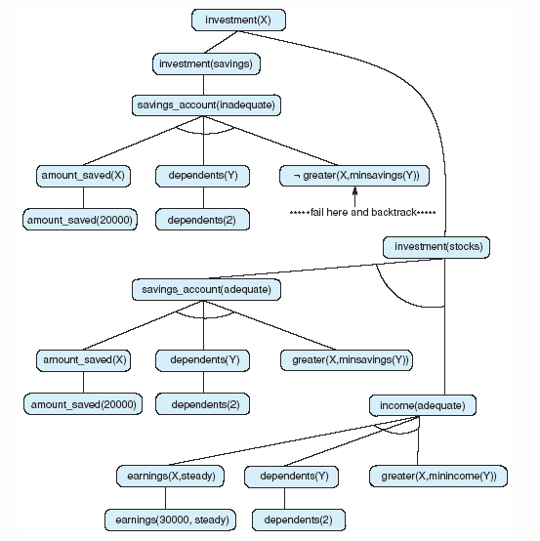
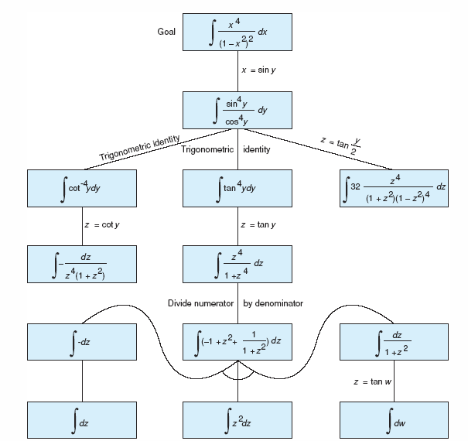
And/Or Graphs as Search Spaces
Integration by parts, as used in the
MACSYMA expert system –
if we use the middle branch, we must
solve all 3 parts (in the final row)
Our Financial Advisor system from chapter 2 – each possible investment
solution requires proving 3 things

Slide 17
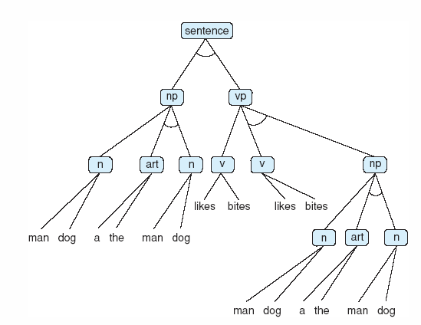
Data-driven Example: Parsing
We wrap up this chapter by considering an example of syntactically parsing an English sentence
we have the following five rules:
sentence → np vp
np → n
np → art n
vp → v
vp → v np
n is noun
man or dog
v is verb
likes or bites
Art is article
a or the
Parse the following sentence:
The dog bites the man.

